Slide 1
TEACHER CUE
CFU
HINT
Scaffolding for students
MAKE THE CONNECTION
Allow students to make the connection

Slide 2
HINT
Waste Cells Removal Respond Cells Energy
Sensitivity is the way in which organisms ____________to their environment.
Respiration is not only breathing. Instead, it is the conversion of _________ from carbohydrates that happens inside your ________.
Excretion is the ___________of ______ products from the body
All living organisms are made up of ______.

Slide 3
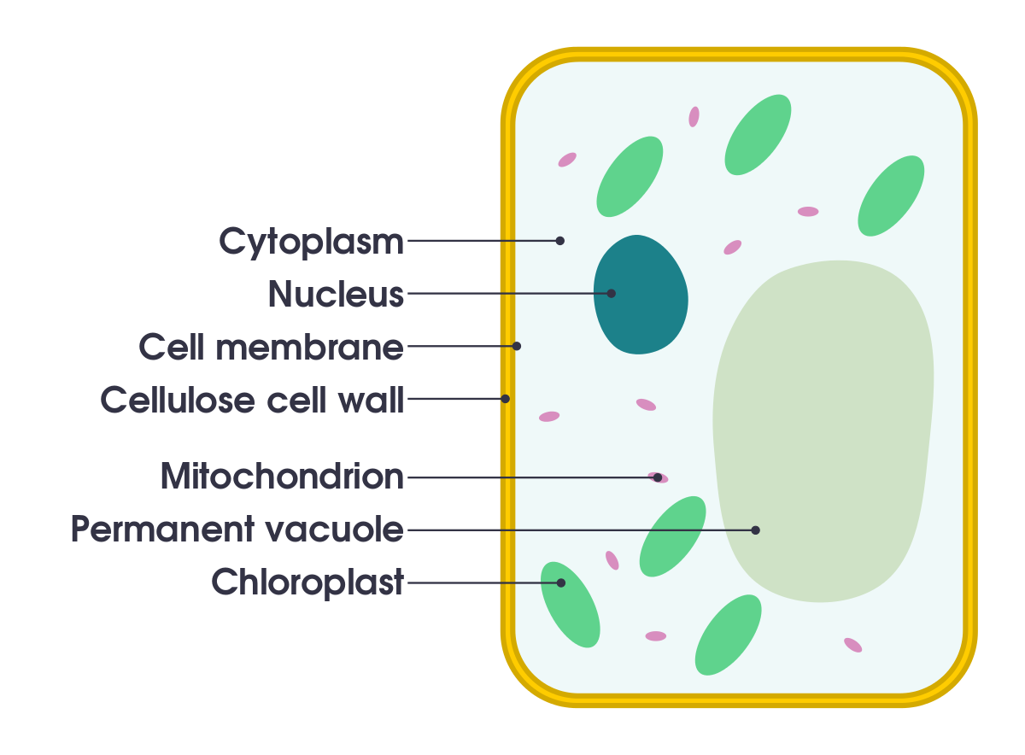
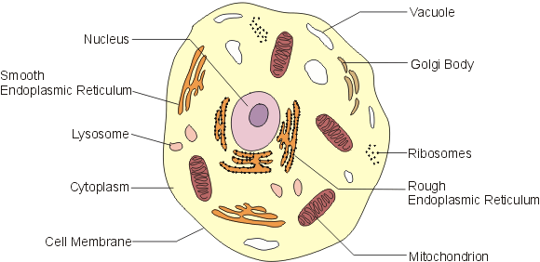
Which is which cell?

Slide 4
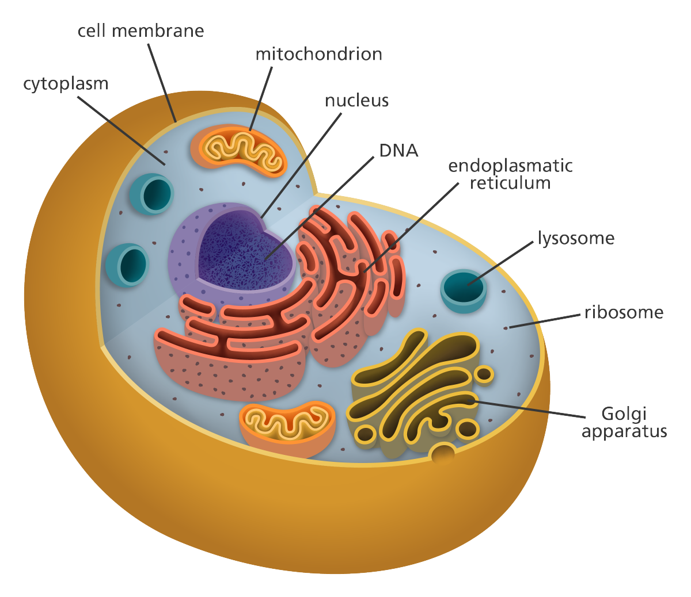
Match the term to the part of the cell

Slide 5
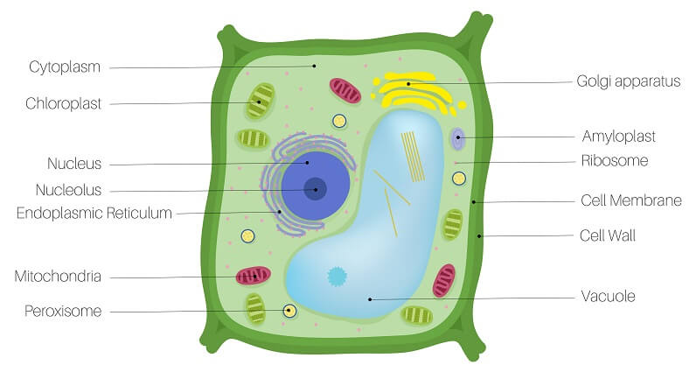

Slide 6
Match the term and the definition
Nucleus
Golgi apparatus
Ribosome
Chloroplast
Cell wall
Part of the cell that undergoes photosynthesis
Provides structural support in a plant cell and controls shape
Creates proteins in this part of the cell
Packages, modifies and sends proteins around the cell
Control centre of the cell that holds DNA, and regulates growth and metabolism

Slide 7
I will be able to describe the function of Mitosis and the steps involved
TRACK WITH ME
READ WITH ME
I can name different phases of mitosis
I know what is involved in each phase of mitosis
I can discuss the importance of mitosis

Slide 8
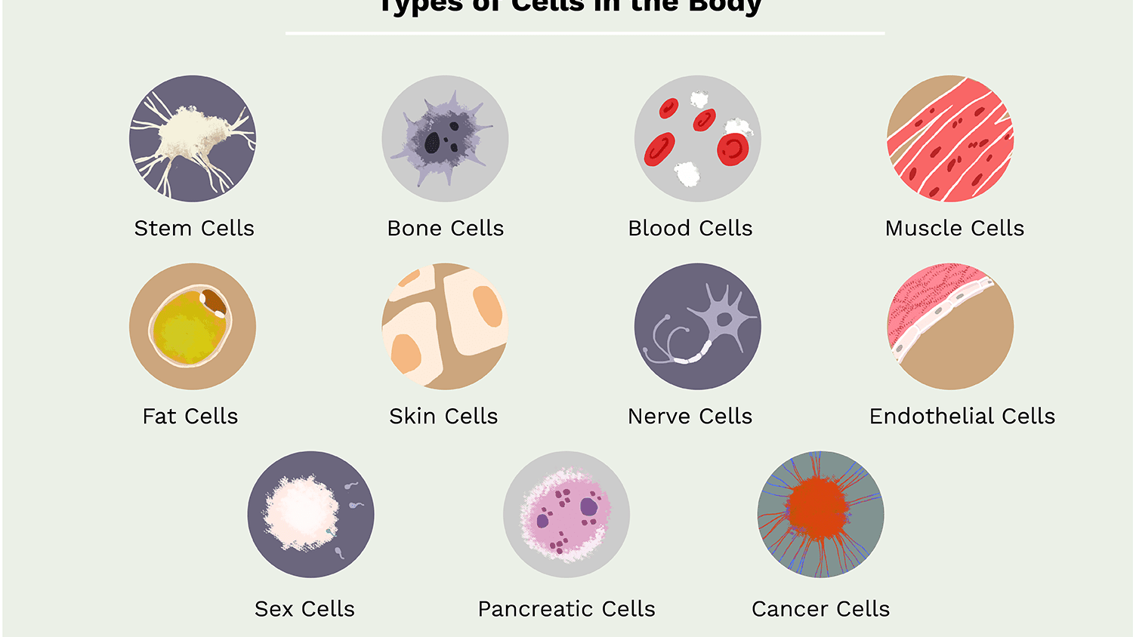
I will be able to describe the function of Mitosis and the steps involved
In the human body we have trillions of cells that work together.
These are some of the types of cells in the human body.

Slide 9
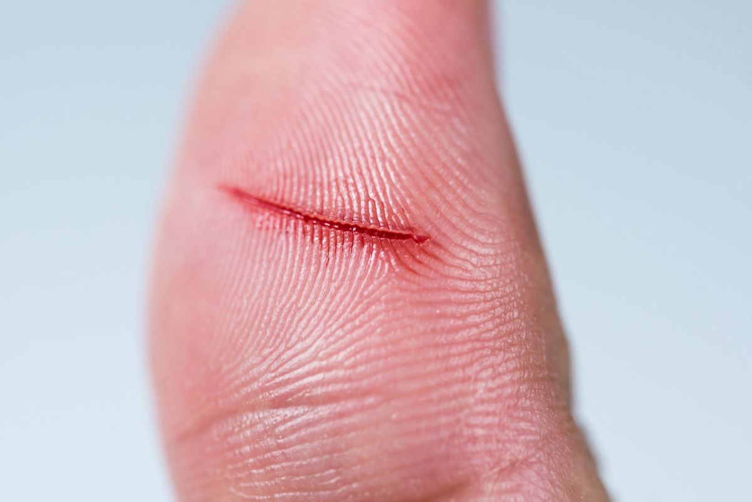
I will be able to describe the function of Mitosis and the steps involved
What happens when you cut your finger?
Will this cut last forever?
The skin will eventually grow and repair itself
This process is called MITOSIS

Slide 10
I will be able to describe the function of Mitosis and the steps involved
Vocabulary
Mitosis
Mitosis is the process of cell division that creates two identical cells.
This process is essential for growth and repair in living things.

Slide 11
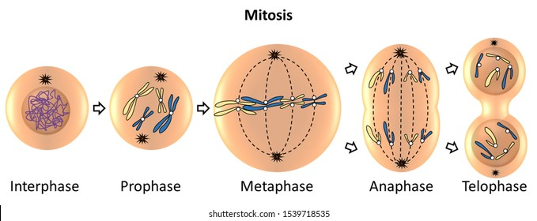
I will be able to describe the function of Mitosis and the steps involved
Mitosis
During mitosis one cell divides to make two identical copies (called daughter cells).

Slide 12
I will be able to describe the function of Mitosis and the steps involved
Fill in the blanks
Mitosis
Mitosis is they way in which we ________ and grow _______ to make ___________ copies of the cell.

Slide 13
I will be able to describe the function of Mitosis and the steps involved
Mitosis produces how many daughter cells?

Slide 14
I will be able to describe the function of Mitosis and the steps involved
This is what mitosis looks like.

Slide 15
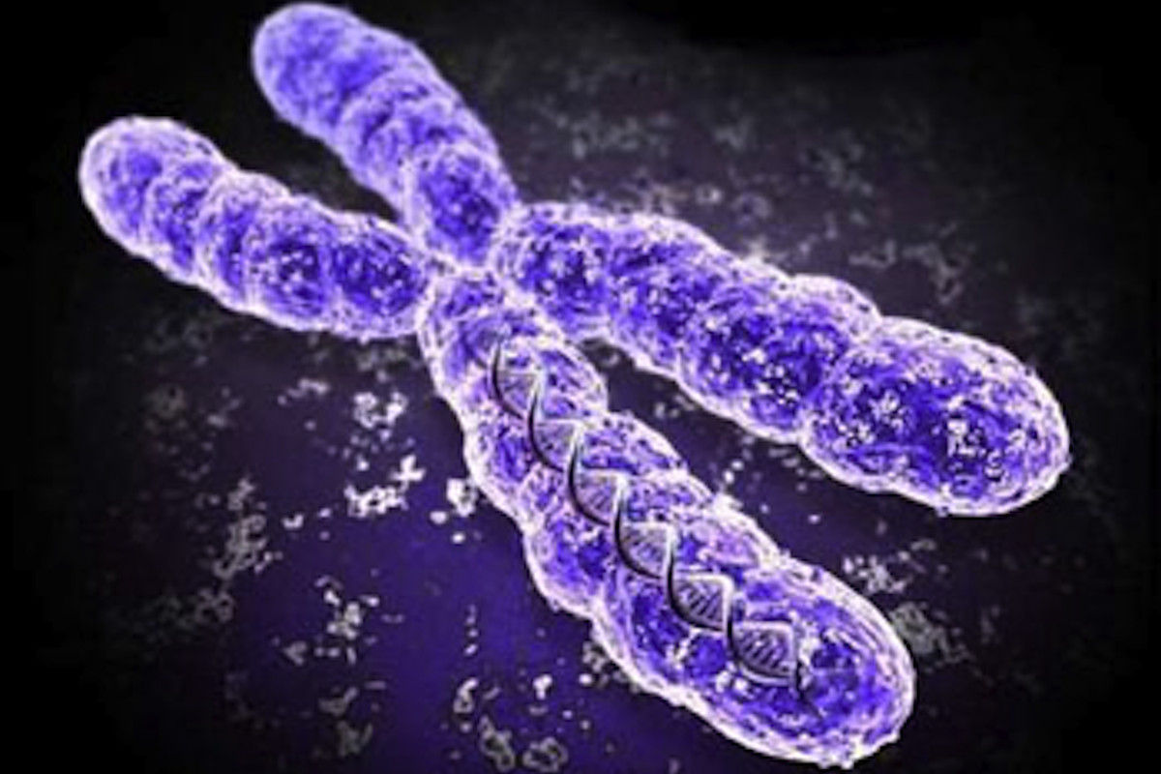
I will be able to describe the function of Mitosis and the steps involved
Inside the cell are chromosomes.
Chromosomes are a threadlike structure inside the nucleus carrying genetic information known as genes.

Slide 16
I will be able to describe the function of Mitosis and the steps involved
There are a number of stages that you will need to remember. This is how we remember
I I nterphase
P lay P rophase
M inecraft M etaphase
A t A naphase
T he T elophase
C rib C ytokinesis

Slide 17
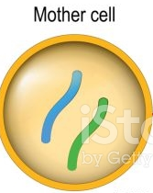
STEPS OF MITOSIS
Stage 1: Interphase
This is the phase in cell spends the most of its life and is the stage before mitosis and changes begin

Slide 18
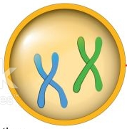
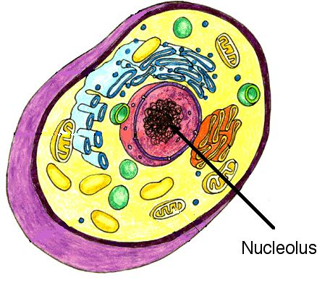
STEPS OF MITOSIS
HINT
Pro- means to go forward or advance
Stage 2: Prophase
During prophase the chromosomes thicken and coil. A spindle is formed and the nucleolus shrinks and disappears.

Slide 19
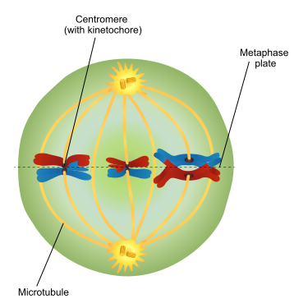
STEPS OF MITOSIS
HINT
Meta- means to go after or along with
Stage 3: Metaphase
In this stage the chromatids (double structure of chromosomes) line up along the equator (middle)

Slide 20
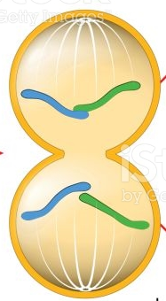
STEPS OF MITOSIS
HINT
Ana- means to go up or against
Stage 4: Anaphase
During the anaphase each chromatid pair separates into individual chromosomes. These get pulled to opposite ends.

Slide 21
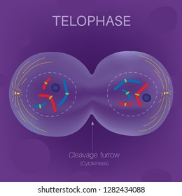
STEPS OF MITOSIS
HINT
Telo- means the end
Stage 5: Telophase
During telophase the chromosomes begin to decondense, the spindle breaks down and the nuclear membranes reform.
Telophase is often joined with cytokinesis

Slide 22
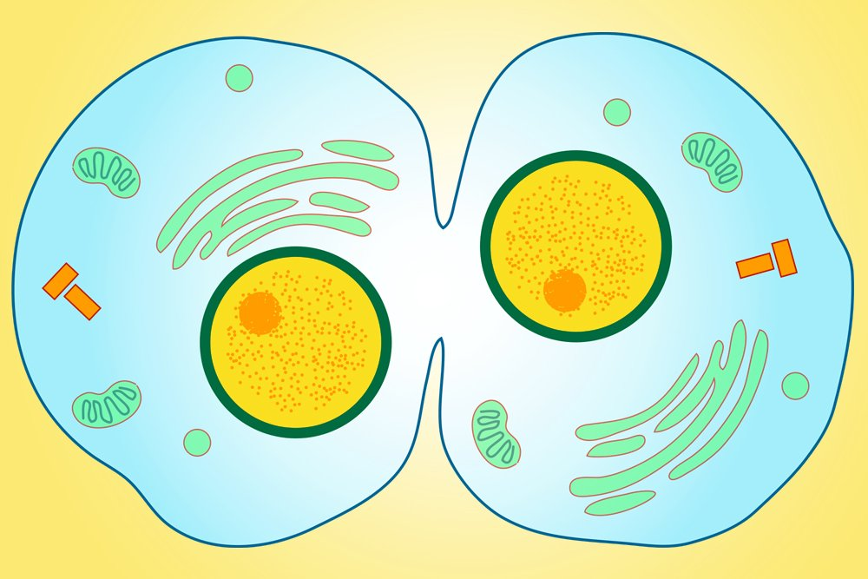
STEPS OF MITOSIS
HINT
Telo- means the end
Stage 6: Cytokinesis
This is the final stage and total separation of cells which are then back in the interphase stage.
Can you now see two cells formed with the other organelles?

Slide 23
I will be able to describe the function of Mitosis and the steps involved
Why is mitosis essential?
This process provides new cells for growth and replacement of worn-out cells.
This may take minutes or hours depend on which type of cell.

Slide 24
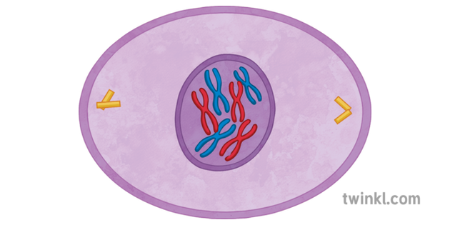
I will be able to describe the function of Mitosis and the steps involved
Which is this phase?

Slide 25
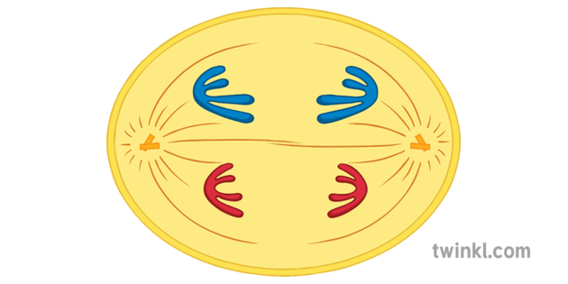
I will be able to describe the function of Mitosis and the steps involved
Which is this phase?

Slide 26
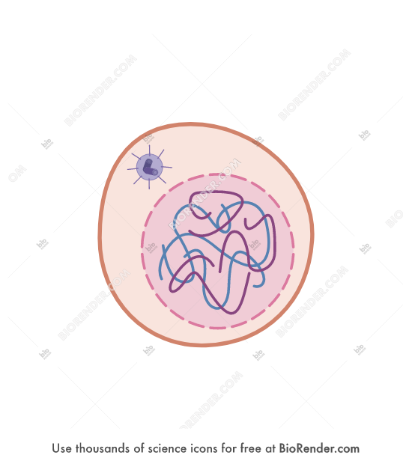
I will be able to describe the function of Mitosis and the steps involved
Which is this phase?

Slide 27
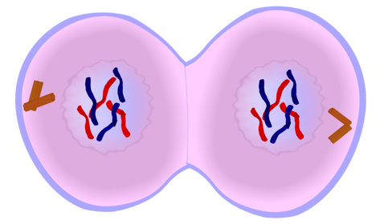
I will be able to describe the function of Mitosis and the steps involved
Which is this phase?

Slide 28
I will be able to describe the function of Mitosis and the steps involved
Quest Textbook
Can you now complete these questions on mitosis.

Slide 29
I will be able to describe the function of Mitosis and the steps involved
TRACK WITH ME
READ WITH ME
I can name different phases of mitosis
I know what is involved in each phase of mitosis
I can discuss the importance of mitosis

